Slide 1



Lecture On : Problem Identification
Instructor :Mukesh Lal

Slide 2
EXECUTION AND IMPLEMENTATION - OBJECTIVE
1
Discovery
2
Strategic Prioritisation
3
Tactical Planning
4
Execution and Implementation

Slide 3
DISCOVERY PHASE - MINDMAP
Given a business, identify decisions points that impact the business.
Step 1: Identify high-value items
Step 2: Identify problems in these high-value items
Step 3: Map ML/AI solutions to these problems
Step 4: Create use case canvas for each use cases

Slide 4
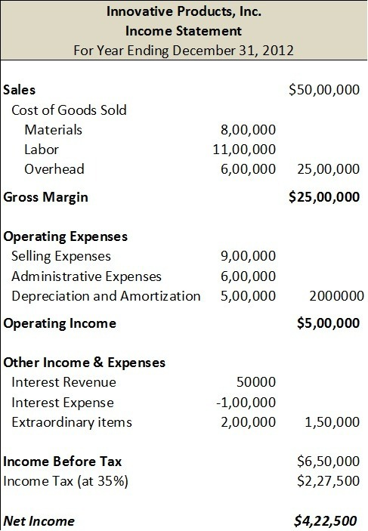
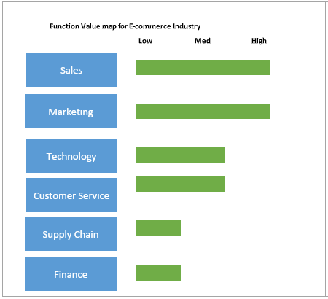
STEP 1 – FOLLOW THE MONEY
Use Profit and Loss statement
Follow KPIs
Prioritize Functions
Divide the entire company into smaller segments, a few ways to do which are mentioned below
Each of the business process will have a critical KPI defining its effectiveness.
Identify the KPIs that best align with the company’s strategy and focus on them.
Average order size
Gross profit
Conversion rate
Shopping cart abandonment rate
Product affinity
Product relationship
Inventory levels
Competitive pricing
Customer lifetime value (CLV)
Revenue per visitor (RPV)
Churn rate
Customer acquisition cost (CAC)
A business can be divided in to different functions as shown in the figure below
Focus on the functions with high value
Looking at the P&L statement can be a great way to identify high-value items.
Prioritize Functions
Use Profit and Loss statement
Follow KPIs

Slide 5
STEP 2 – IDENTIFY BUSINESS PROBLEMS FOR HIGH-VALUE ITEMS
Consider a situation where you have been asked to address the following business challenges
P1
Cross-Sell/Up-Sell products across customer segments
P2
Prevent customer churn by deploying retention strategies for high probable churn customers

Slide 6
STEP 3 – MAP AI SOLUTIONS FOR THE BUSINESS PROBLEMS
Consider a project where you have been asked to reduce the cost of customer acquisition.
P1
Cross-Sell/Up-Sell products across customer segments
A:
Build a recommendation engine to personalise product recommendations to the customers
P2
Prevent customer churn by deploying retention strategies for high probable churn customers
A:
Build a customer churn model to identify customers with high propensity to churn

Slide 7
STEP 4 – CREATE A USE CASE CANVAS
Use case Canvas - <Use case Name>
Business Problem | Business Solution | End User(s)
<Define the business problem> | <Define the business solution> | <Who is going to use the output?>
Data Required | Infrastructure Required | Skills Required
<Define the data required, time period etc.> | <Specifiy the Infrastructure required (On-prem/Cloud) - hardware, GPUs, Tools, Software etc.> | <Specifiy the skills required - NLP, Computer Vision, Big Data, Cloud computing, Domain Expertise etc.>
Cross Functional Teams | Processes to be Changed | Success Criteria
<Identify the teams that are required to support the project - IT, engineering, customer support etc.> | <Identify the downstream changes required - app, website, contact centre etc.> | <Which lead/lag KPIs need to be measured?>

Slide 8
Thank You!

